Slide 1
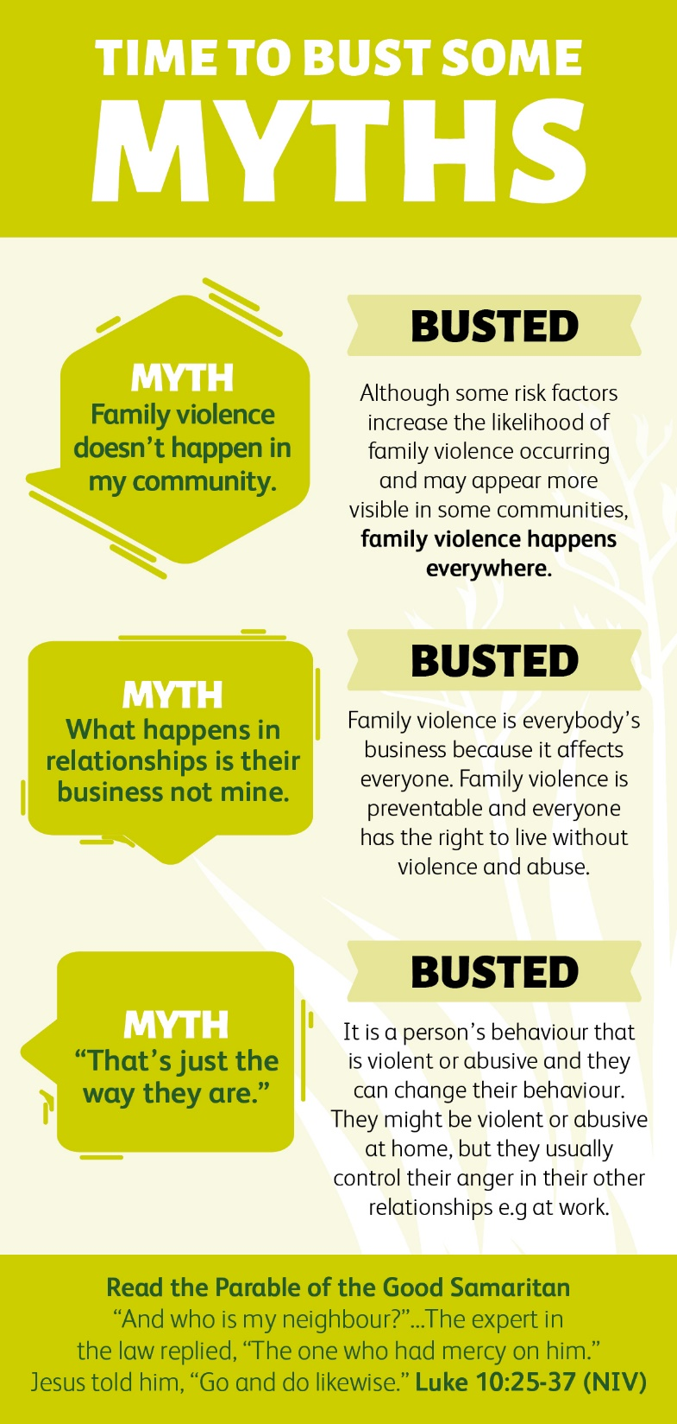

Slide 2
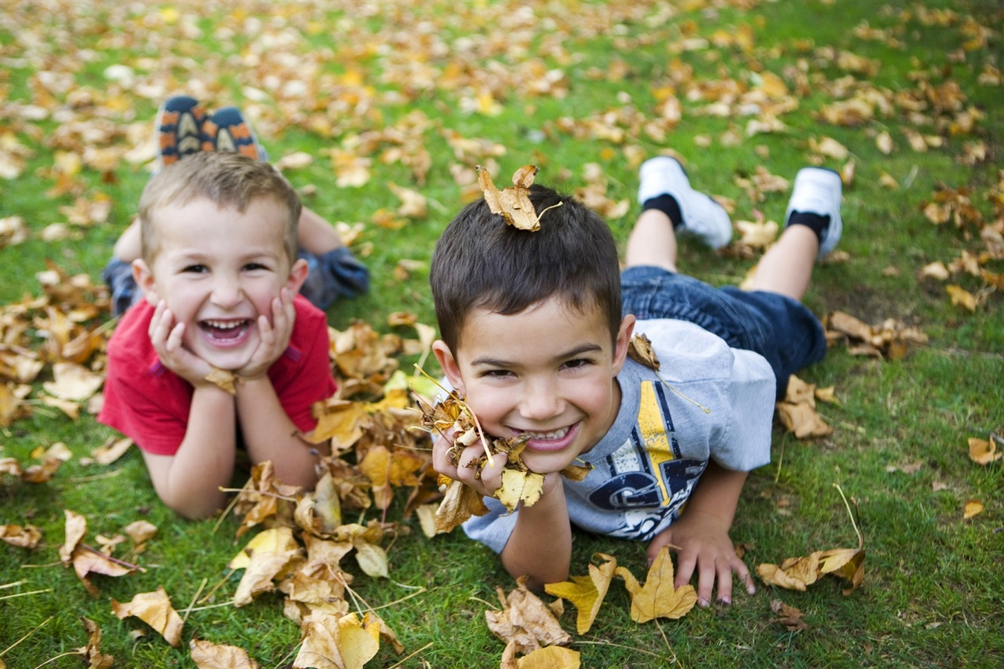
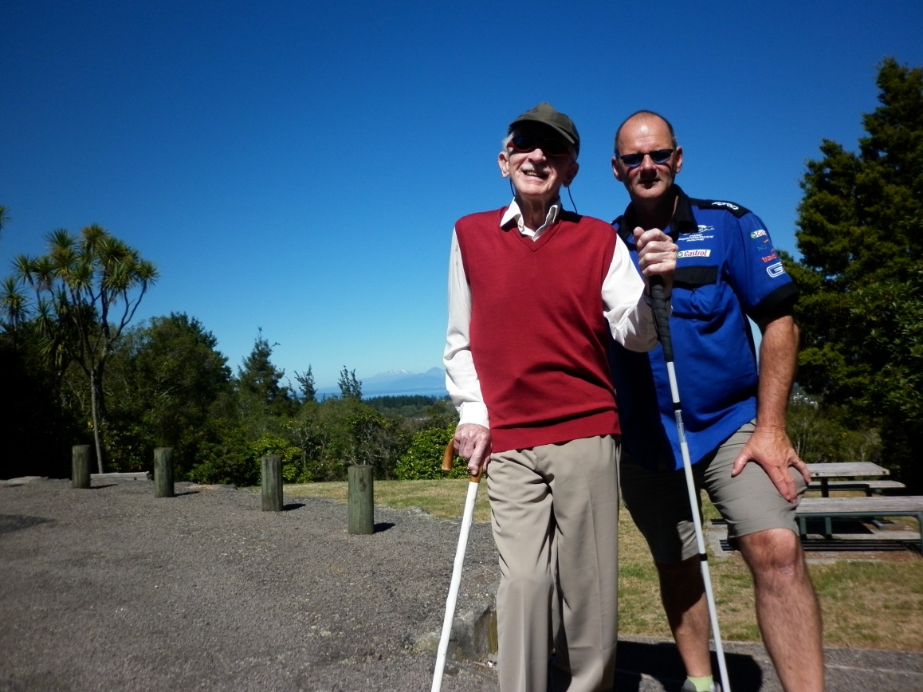

Slide 3
Building, safe, strong, connected families
Imagine of girls – praying for Children @ Risk

Slide 5
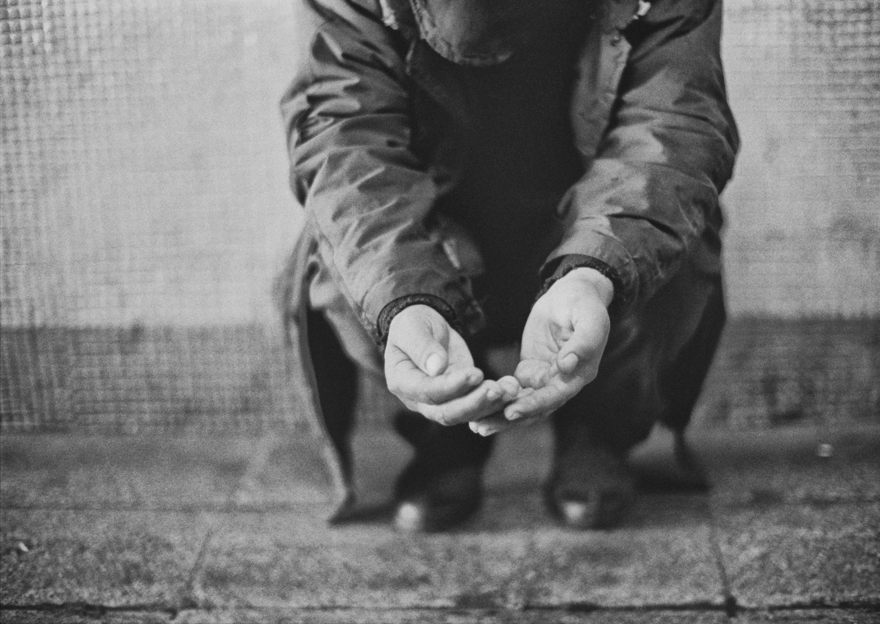
A Justice Model
Brings about social changes and responds to long term needs, focusing on the root causes of social problems
Justice & Charity Models
A Charity Model
Responds to the immediate needs and offers practical support

Slide 6
“You have to be able to image lives that are not yours”
Wendell Berry

